Slide 1
Data Visualization & Reporting
By Bansi Saboo

Slide 2
01
Introduction
02
Dashboards (Introduction, Mockup, Demo)
Contents
03
Data Source
04
Tool Selection
05
Dashboard Demo
06
Update Plan

Slide 3

1. Introduction
The project focuses on the cutting-edge dashboard designed to revolutionize Amazon's operations showcasing how our comprehensive dashboard enhances decision-making and strategic planning across Amazon's key departments.
Our dashboard addresses this need by offering a consolidated view, providing actionable data-driven insights for informed decision-making. As we navigate through the intricacies of Amazon's operations, we've harnessed the potential of data visualization to create a unified platform for four distinct departments: HR, Sales, Inventory, and Reviews.

Slide 4
HR Dashboard
Amazon

Slide 5

i. Human resources (HR) - Introduction
Human resources (HR) play a crucial role in managing an organization's workforce and ensuring the effective utilization of human capital. HR departments are responsible for various functions such as recruitment, employee onboarding, performance management, training and development, employee engagement, and more.
Our dashboard shows how HR makes all this happen, using charts and numbers to tell the story of Amazon's HR success.

Slide 6
ii. Dashboard Mock-up
Question Focused on dashboard mock-up are given below:
Number of Employees?
To find out how many employees are working in total and in a specific year
Male | Female?
To find out how many male employees and female employees working in the company
Average Tenure of Employees?
To find out average tenure of employees as per their race
Performance Rating
To find out performance of each departments of the company
Age Distribution
To find out the age of employees working on the company

Slide 7
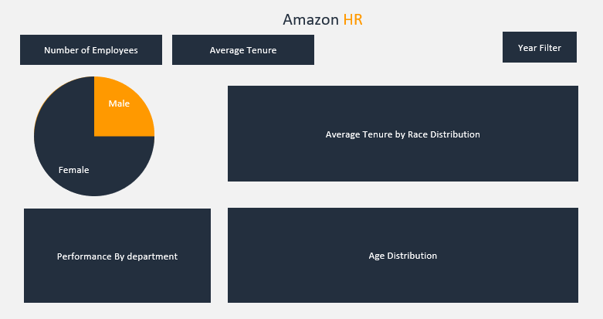
iii. Dashboard Mock-up Plan

Slide 8

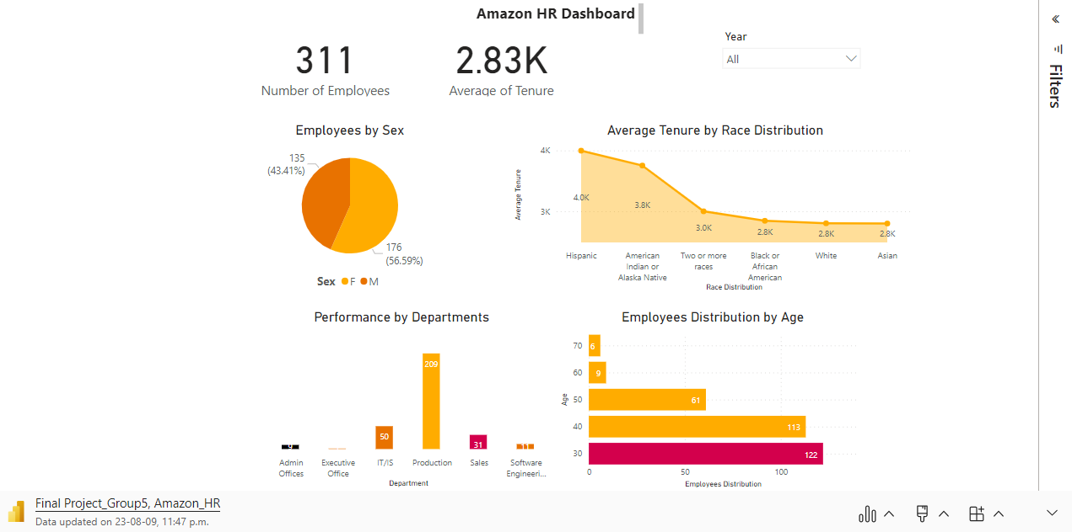
Microsoft Power BI – Dashboard Live Demo

Slide 9
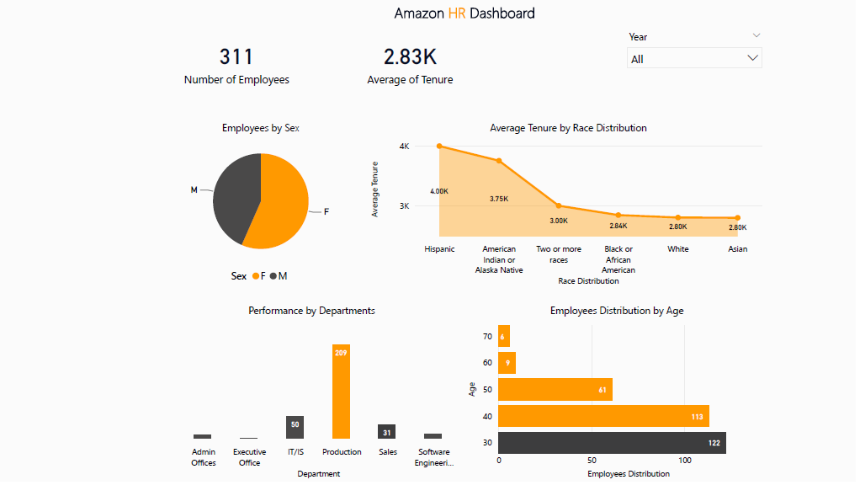
Sample Snippet
Amazon HR dashboard demo is given below:

Slide 10
Reviews Dashboard
Amazon

Slide 11

i. Consumer Reviews - Introduction
In today's connected world, what customers say matters a lot to businesses. This is where the Consumer Reviews section of our dashboard comes in – it shows us the important things that customers are saying.
Consumer reviews are like a bunch of opinions and experiences from people who use products and services. They give us a peek into how things really work in the real world, showing the gap between what we expect and what we actually get. As we begin exploring this, let's dive into the world of consumer reviews. Here, we use data to tell stories that help us make better decisions, improve products, and make customers happier.

Slide 12
ii. Dashboard Mock-up
Outlined below are the inquiries that specifically target the content and layout of the dashboard mock-up:
1. Review Statistics Overview:
How many total reviews are available in the dataset?
What is the breakdown of reviews by manufacturer?
2. Review Categorization:
How many reviews are there for each category?
Can I see the distribution of reviews across different categories?
3. Review Text Analysis:
How many reviews have associated text/comments?
4. Helpfulness Analysis:
How many reviews have been marked as helpful by other users?
Could you show me the ratio of helpful reviews to total reviews?
5. Manufacturer Insights:
Which manufacturer has the highest number of reviews?
Is there a breakdown of helpful reviews for each manufacturer?
6. Category Specifics:
What are the top categories with the most reviews?
Can I see a list of reviews IDs for a specific category?

Slide 13
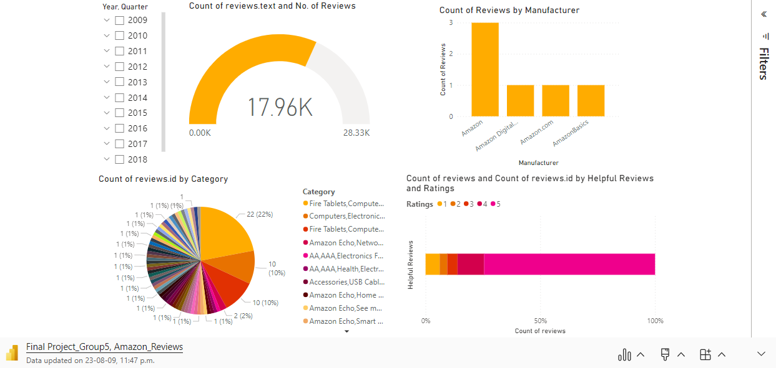
Microsoft Power BI – Dashboard Live Demo
Amazon Reviews

Slide 14
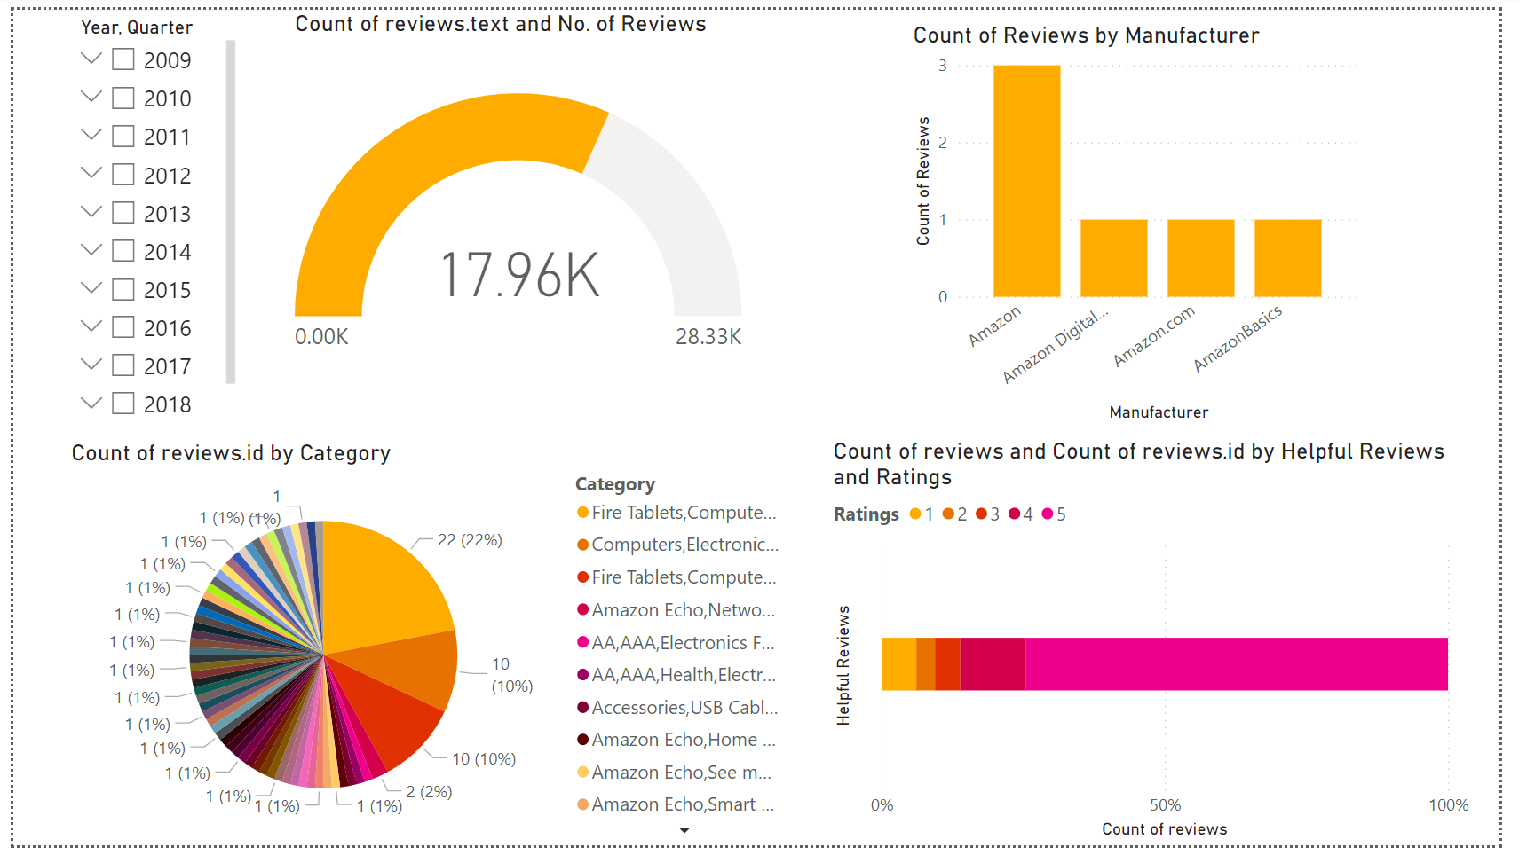
Sample Snippet
Amazon Reviews dashboard demo is given below:

Slide 15
Sales Dashboard
Amazon

Slide 16

i. Sales Dashboard - Introduction
The Sales Dashboard serves as a compass, guiding us through the complexities of our sales landscape. Here, data transforms into meaningful stories, helping us understand what products are resonating with customers, which markets are thriving, and how our strategies translate into real-world outcomes.
Join us as we navigate through the corridors of sales analytics, where figures come to life and trends take shape. From revenue streams to product popularity, this dashboard equips us with the tools to make informed decisions, fine-tune our approach, and pave the way for sustained success. Let's dive in and explore the dynamic world of sales data, where every number has a story to tell.

Slide 17
ii. Dashboard Mock-up
Question Focused on dashboard mock-up are given below:
Subscriber’s age, gender etc?
TO identify targeted audiences for next campaigns
Male | Female?
To find out how many male and female have subscribed
Revenue and Sales
To set realistic goals for company, track the revenue
Conversion on rates
To find out conversion ratio of the company
Average order value
To find out the avg sales

Slide 18
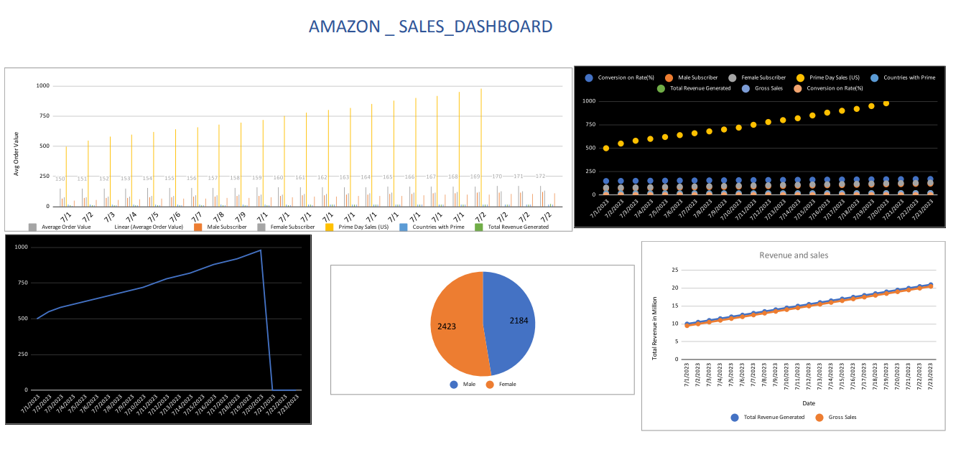
Dashboard Snippet

Slide 19
Inventory Dashboard
Amazon

Slide 20
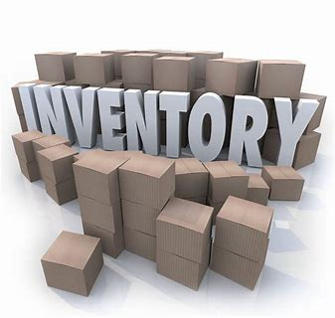
i. Inventory Dashboard - Introduction
The Inventory Dashboard provides a panoramic view of our inventory ecosystem, guiding us through the labyrinth of stock movement and allocation. Here, data transforms into insights, enabling us to optimize stock levels, minimize shortages, and ensure timely deliveries to meet customer expectations.
Join us on a journey of inventory exploration as we decode the language of stock data. From inventory turnover to reorder points, this dashboard empowers us to make informed decisions, streamline our operations, and maintain a resilient supply chain. Let's delve into the world of inventory analytics, where data shapes efficiency and keeps our operations running smoothly.

Slide 21
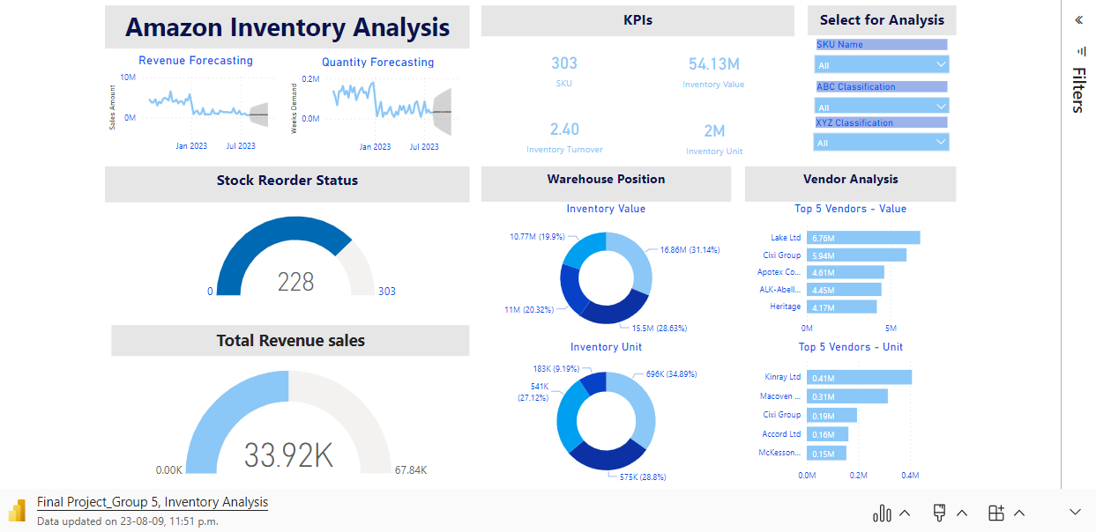
Microsoft Power BI

Slide 22
3. Data Sources
For accuracy and up-to-date information, we relied on a comprehensive data source.
We collected the data from a secondary source, specifically the website kaggle.com. You can find the data source we used by following this link:
i. HR: Human Resources Data Set | Kaggle
ii. Reviews: Consumer Reviews of Amazon Products | Kaggle
iii. Inventory: Inventory Management | Kaggle
iv. Sales: Amazon Sales Dataset | Kaggle
Kaggle.com
HR Dashboard

Slide 23

4. Tool Selection
To craft this informative dashboard, we used Microsoft Excel for data preparation, transformation, and initial analysis.
Following that, we harnessed the capabilities of Power BI, a robust business intelligence tool, to create interactive and meaningful visualizations that effectively communicate our insights.
Microsoft Excel
Power BI

Slide 24
5. Update Plan
Ensuring the dashboard remains pertinent is of paramount importance. We have devised a strategy for updates, assuring ongoing currency and enduring value in the insights provided. This approach encompasses routine data refreshes, quarterly assessments of pivotal metrics, and integration of input from HR stakeholders to align with evolving requirements.
Here are several approaches to maintain the relevance of the dashboard and ensure that insights remain up-to-date and valuable over time:
Regular Data Refreshes: Set up automated processes to refresh the underlying data at regular intervals. This ensures that the information displayed on the dashboard is current and reflects the most recent data.
Real-time Data Integration: Implement real-time data integration to provide users with instant access to the latest information. This is particularly useful for time-sensitive metrics and dynamic data sources.
Automated Alerts: Set up automated alerts or notifications to inform stakeholders when specific metrics or data points reach predefined thresholds. This ensures timely attention to important changes.
Scheduled Reviews: Conduct periodic reviews of the dashboard's content and metrics. This can be done on a quarterly or semi-annual basis to ensure that the displayed insights remain aligned with business objectives.
User Feedback Integration: Actively solicit feedback from dashboard users, especially key stakeholders. Incorporate their suggestions and requirements to tailor the dashboard to their evolving needs.

Slide 25
thanks!
We are now open to questions and feedback.

